Slide 1
IT Infrastructure and Emerging Technologies
VIDEO CASES
  Case 1: ESPN.com: Getting to eXtreme Scale On the Web
  Case 2: Salesforce.com: Managing by Smartphone
  Case 3: Hudson's Bay Company and IBM: Virtual Blade Platform

Slide 2
Learning Objectives
Define IT infrastructure and describe its components.
Identify and describe the stages and technology drivers of IT infrastructure evolution.
Assess contemporary computer hardware platform trends.
Assess contemporary software platform trends.
Evaluate the challenges of managing IT infrastructure and management solutions.
Notes:
Are students familiar with any of the trends in hardware or software platforms? Do they see the iPhone/iPad for instance as a device, a computing platform, or a just a telephone? They might be familiar with developments such as Facebook’s Application platform, where developers can design games and activities for use within Facebook itself. Also recall that cloud computing has been mentioned in earlier chapters, so students should be able to point to that as a contemporary hardware platform trend.

Slide 3
IT Infrastructure
IT infrastructure:
  Set of physical devices and software required to operate enterprise
  Set of firmwide services including:
    Computing platforms providing computing services
    Telecommunications services
    Data management services
    Application software services
    Physical facilities management services
    IT management, education, and other services
  “Service platform” perspective
    More accurate view of value of investments
Notes:
The “service platform” perspective refers to analyzing the actual services enabled by new technology tools. For example, a new PC might save an employee one hour per day in wait time for information, dramatically increasing his or her value to the firm.

Slide 4
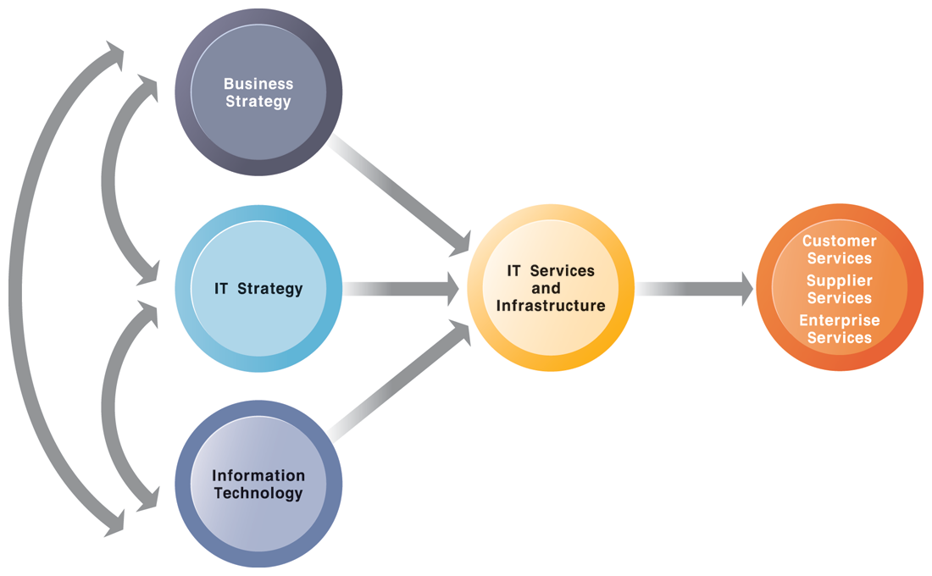
CONNECTION BETWEEN THE FIRM, IT INFRASTRUCTURE, AND BUSINESS CAPABILITIES
FIGURE 1
The services a firm is capable of providing to its customers, suppliers, and employees are a direct function of its IT infrastructure. Ideally, this infrastructure should support the firm’s business and information systems strategy. New information technologies have a powerful impact on business and IT strategies, as well as the services that can be provided to customers.
Notes:
The point of this slide is to illustrate the centrality of IT infrastructure and services to the achievement of firm success. Ultimately, what the firm delivers to customers, its quality, is a direct function of the power of its infrastructure. For instance, Amazon is routinely sited as the most popular online shopping site and receives high praise from customers for the quality of its service and speed of execution. There is a reason for this: Amazon has one of the world’s largest computing infrastructures numbering several hundred thousand processors to provide these services.

Slide 5
IT Infrastructure
Evolution of IT infrastructure
  General-purpose mainframe and minicomputer era: 1959 to present
    1958: IBM first mainframes introduced
    1965: less expensive DEC minicomputers introduced
  Personal computer era: 1981 to present
    1981: Introduction of IBM PC
    Proliferation in 80s, 90s resulted in growth of personal software
  Client/server era: 1983 to present
    Desktop clients networked to servers, with processing work split between clients and servers
    Network may be two-tiered or multitiered (N-tiered)
    Various types of servers (network, application, Web)
Notes:
Students may be unfamiliar with the concept of mainframe computers. Explain the difference in size (much larger) and computing capacity (much smaller) from today’s computers to give them a sense of perspective regarding how far the computing industry has gone in 60 years. However, modern-day mainframes (IBM z-Series), are extremely powerful servers used for large Fortune 1000 enterprise networks and corporate Web sites. The mainframe is not dead in other words and still represents a large revenue stream for IBM.

Slide 6
IT Infrastructure
Evolution of IT infrastructure (cont’d)
  Enterprise computing era: 1992 to present
    Move toward integrating disparate networks, applications using Internet standards and enterprise applications
  Cloud and mobile computing: 2000 to present
    Cloud computing: computing power and software applications supplied over the Internet or other network
      Fastest growing form of computing
Notes:
Examples of the use of cloud computing are Google Apps, Google’s suite of software applications that rivals Microsoft’s Office applications at a fraction of the cost, and Salesforce.com’s CRM management software, delivered over the Internet. Most large Fortune 500 firms have some applications that run in the cloud. Most of these same corporations do not put their strategic or critical systems on the cloud just yet because of lingering concerns about reliability and security.

Slide 7
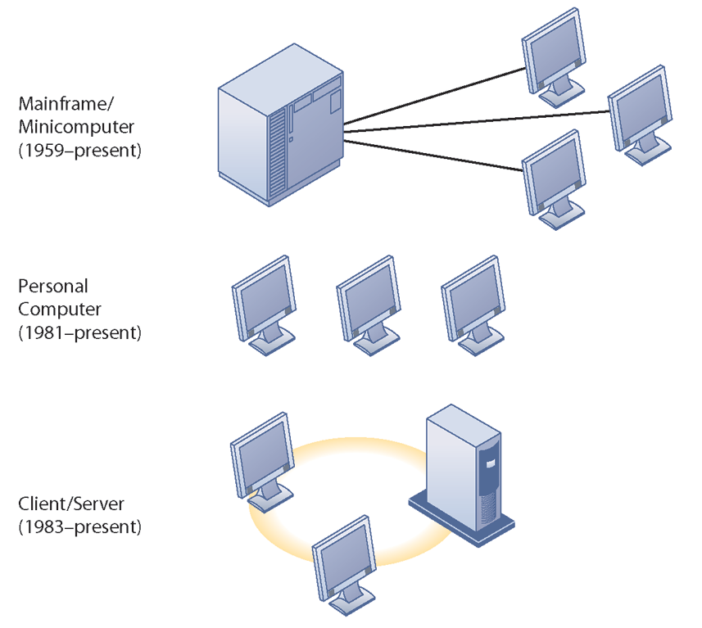
STAGES IN IT INFRASTRUCTURE EVOLUTION
Illustrated here are the typical computing configurations characterizing each of the five eras of IT infrastructure evolution.
FIGURE 2
Notes:
This slide shows the portion of Figure 5-2 that illustrates the first three eras of IT infrastructure evolution discussed in the previous slide. Explain so students understand that the yellow ring connecting the machines in the client-server graphic represents a local area network. Personal computers were stand-alone systems prior to the development of local area networks.

Slide 8
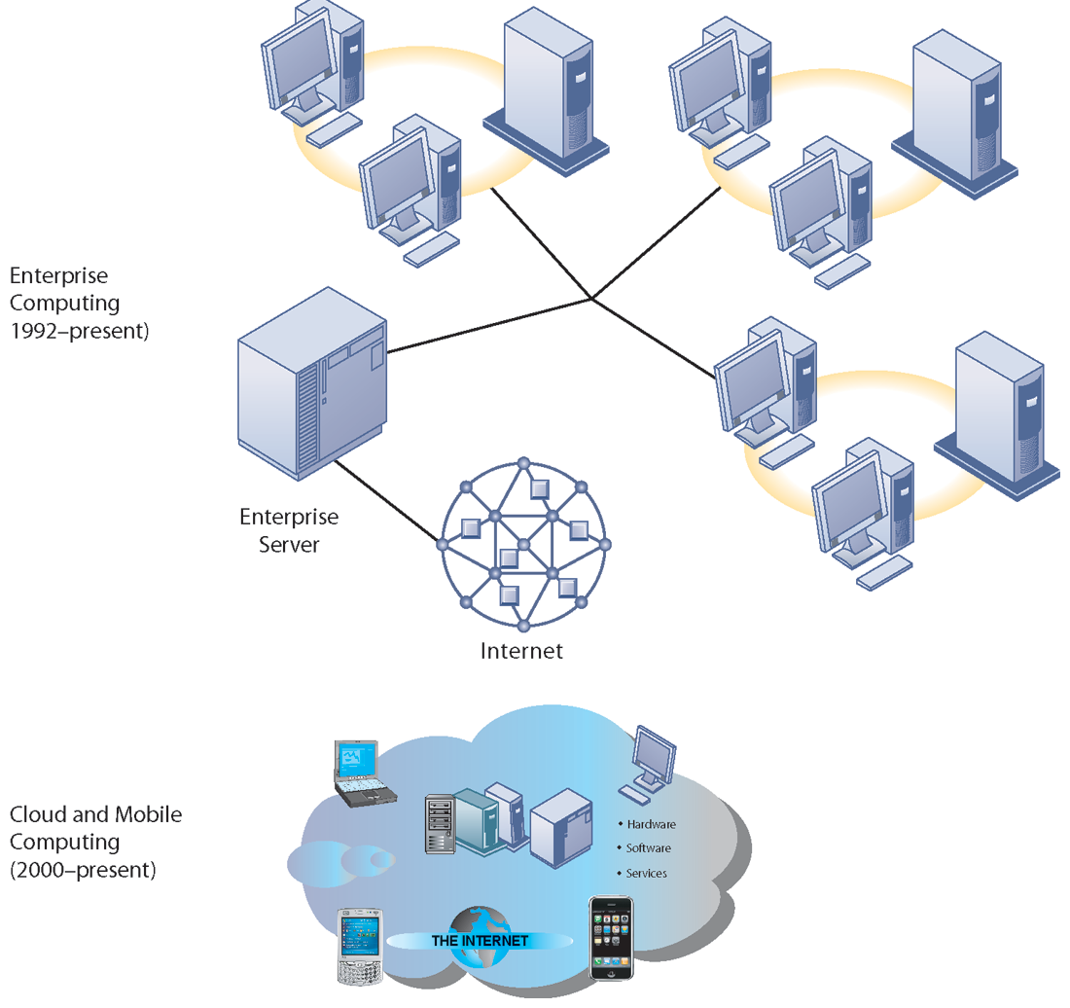
STAGES IN IT INFRASTRUCTURE EVOLUTION (cont’d)
Illustrated here are the typical computing configurations characterizing each of the five eras of IT infrastructure evolution.
FIGURE 3
Notes:
This slide shows the portion of Figure 5-2 that illustrates the last two eras of IT infrastructure evolution discussed in the previous slide. The enterprise Internet graphic represents several individual networks linked together into an enterprise-wide network. The cloud computing graph represents several types of technology that are capable of connecting to the Internet and accessing applications and services through a cloud. There is a Learning Track on the stages of IT infrastructure evolution.

Slide 9
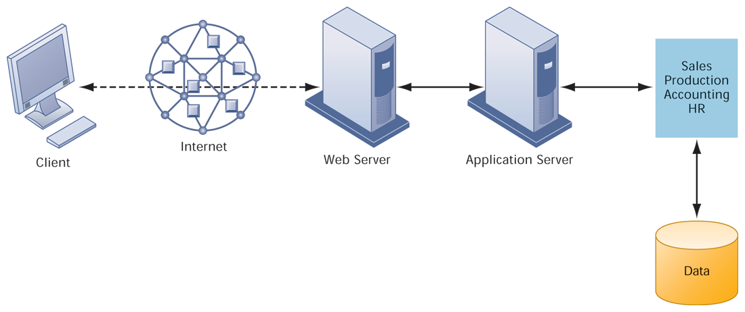
A MULTITIERED CLIENT/SERVER NETWORK (N-TIER)
FIGURE 4
In a multitiered client/server network, client requests for service are handled by different levels of servers.
Notes:
Explain that the distribution of computing power across smaller, less expensive machines enabled by client/server computing is in part responsible for the drastic increase in computing power and applications throughout the firm. Prior to small, less expensive server computers, computing power had to purchased in large blocks at great expense. With client/server computing, you can grow your firm’s inventory of computers gradually, over time, to meet current demand.

Slide 10
IT Infrastructure
Technology drivers of infrastructure evolution
  Moore’s law and microprocessing power – Gordon E. Moore in 1965
    Computing power (no. of ICs & Transistors) doubles every 18 months
    Nanotechnology:
      Shrinks size of transistors to size comparable to size of a virus
  Law of Mass Digital Storage
    The amount of data being stored each year doubles – exponential decrease in cost.
Notes:
Variants of Moore’s Law include: the number of transistors on a chip doubles ever 18 months; computing power doubles every 18 months; and the price of computing falls by half every 18 months. Explain to students that even now, this trend is likely to continue, with transistors reaching the sizes of viruses, the smallest form of life.

Slide 11
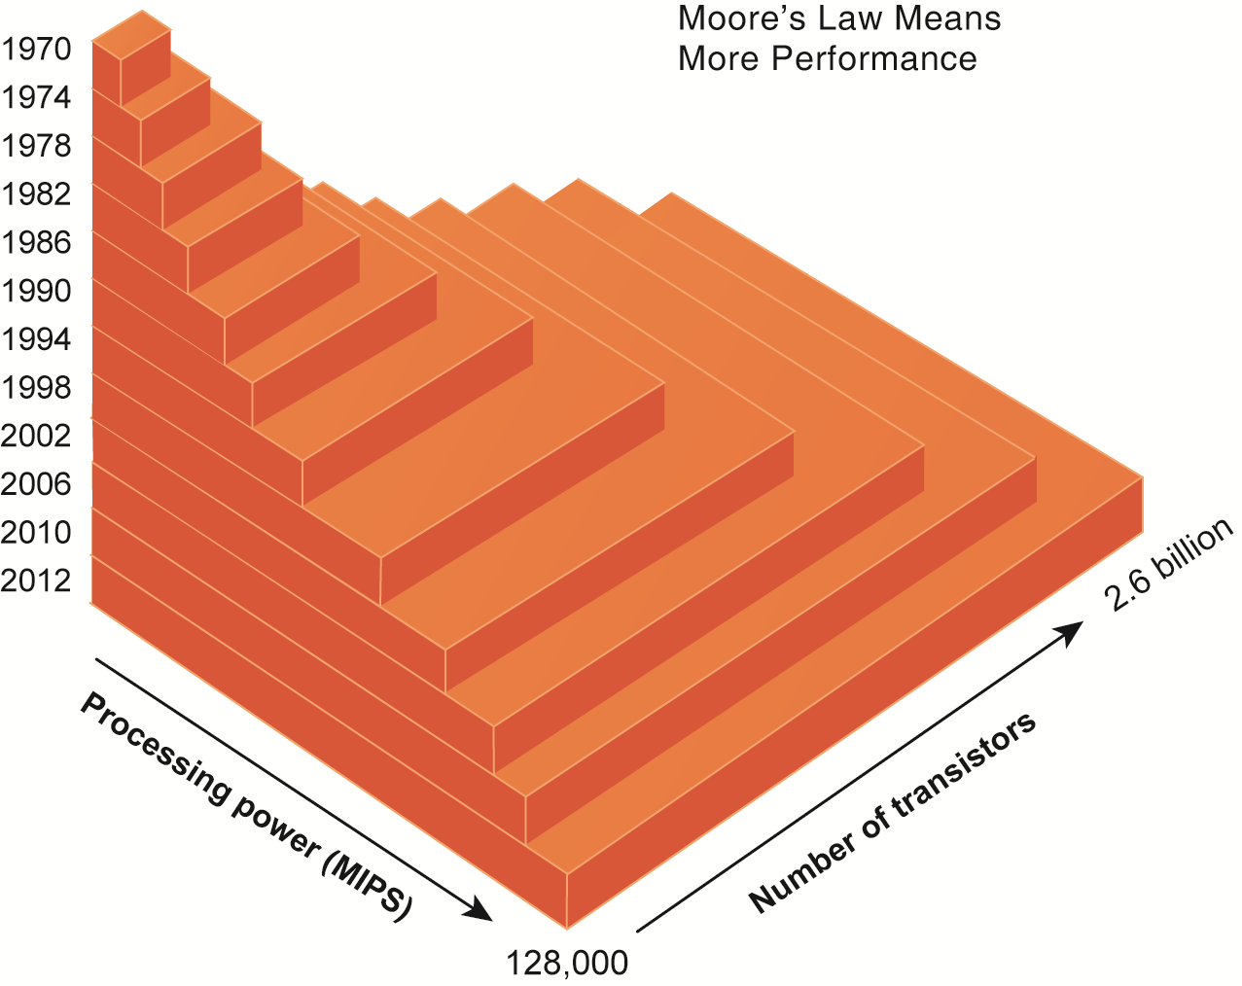
MOORE’S LAW AND MICROPROCESSOR PERFORMANCE
Packing more than 2 billion transistors into a tiny microprocessor has exponentially increased processing power. Processing power has increased to more than 500,000 MIPS (millions of instructions per second).
FIGURE 5
Notes:
At what point, if any, do students believe that the doubling trend of Moore’s Law might come to an end? Ask them to speculate and give reasons for their answers.

Slide 12
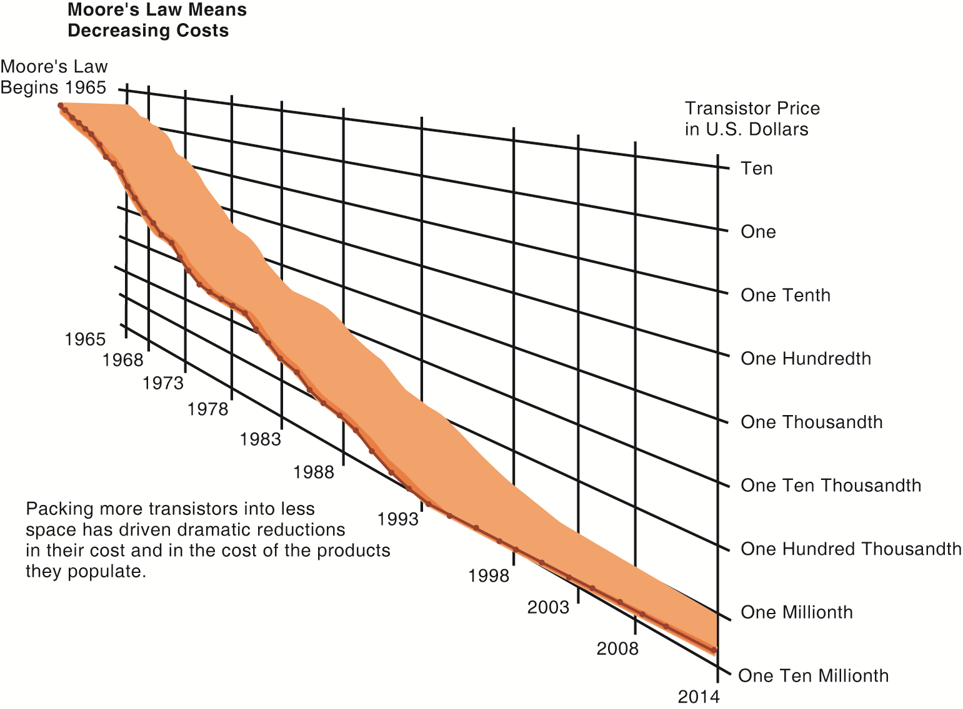
FALLING COST OF CHIPS
Packing more transistors into less space has driven down transistor cost dramatically as well as the cost of the products in which they are used.
FIGURE 6
Notes:
What do students think the implications of such drastically reduced costs of computer chips might be in the future? Explain the connection to concepts such as the digital divide and cloud computing.

Slide 13
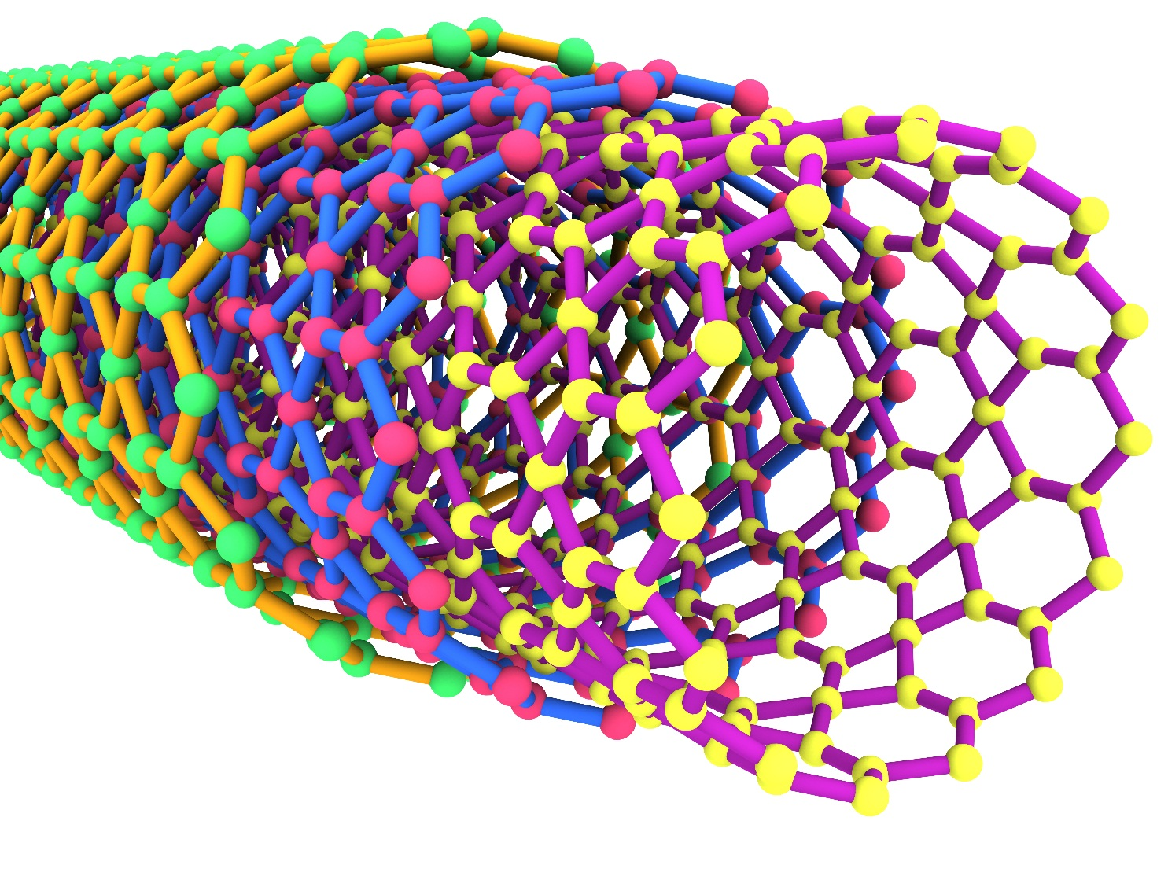
EXAMPLES OF NANOTUBES
Nanotubes are tiny tubes about 10,000 times thinner than a human hair. They consist of rolled up sheets of carbon hexagons and have the potential uses as minuscule wires or in ultrasmall electronic devices and are very powerful conductors of electrical current.
FIGURE 7
Notes:
Nanotechnology is used to create transistors of the tiny size previously mentioned. Can students describe any other applications of this type of technology (for example, medical)?

Slide 14
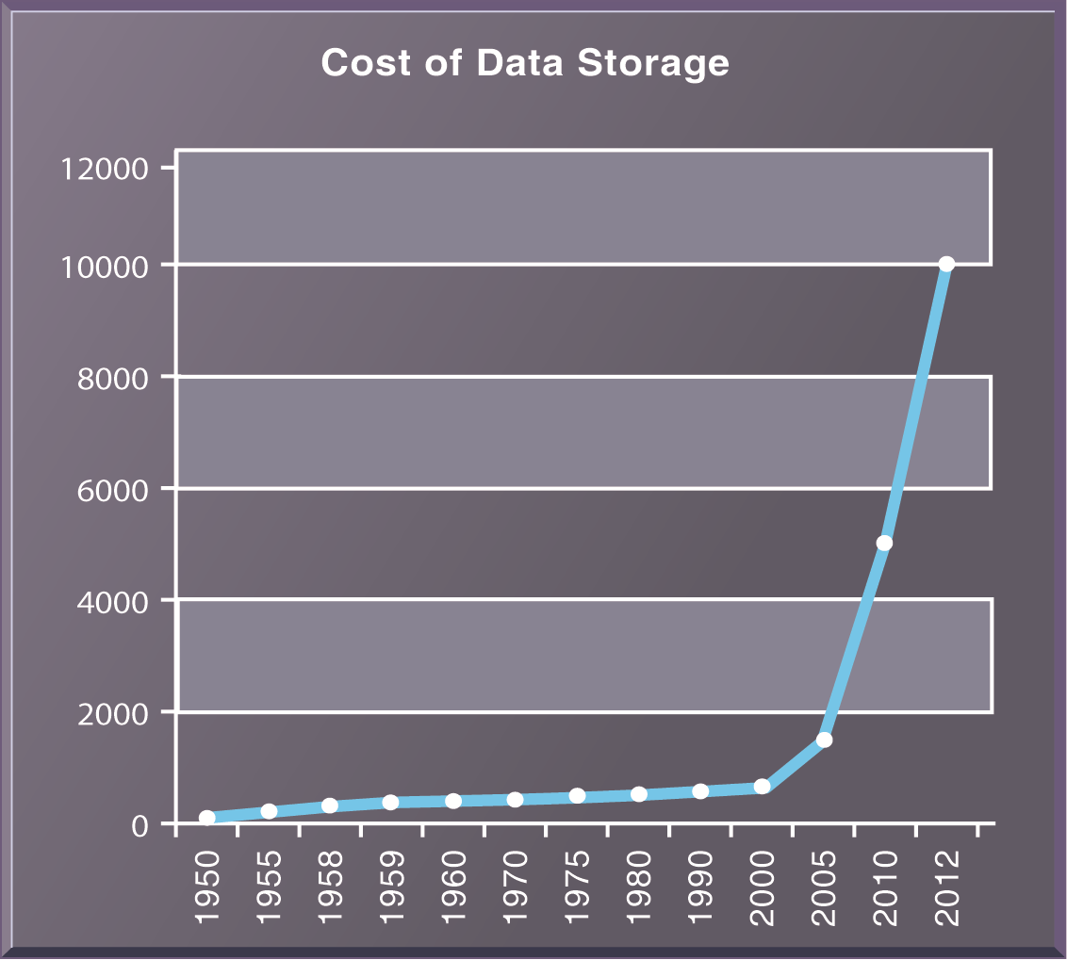
THE COST OF STORING DATA DECLINES EXPONENTIALLY 1950–2012
Since the first magnetic storage device was used in 1955, the cost of storing a kilobyte of data has fallen exponentially, doubling the amount of digital storage for each dollar expended every 15 months on average.
FIGURE 8
Notes:
Explain the importance of the exponential growth in hard drive capacity, which is that the world is producing an increasing amount of digital information requiring storage each year as well. Fortunately, the cost of storing that information is decreasing at an even quicker rate. Explain that this figure displays the number of kilobytes of data that can be stored with one dollar. Point out that the Y axis is greatly compressed to display the doubling effect, and that if it weren’t, the increase from year to year would become increasingly enormous.

Slide 15
IT Infrastructure
Technology drivers of infrastructure evolution (cont’d)
  Metcalfe’s Law and network economics
    Value or power of a network grows exponentially as a function of the number of network members - (n²) – George Gilder (1993) but attributed to Robert Metcalfe – co-founder of Ethernet, founder of 3Com.
    As network members increase, more people want to use it (demand for network access increases).
Notes:
Ask students to explain the implications of Metcalfe’s law to social networks, such as Facebook and MySpace. Do they agree that the more members are using the site, the value of being a member and the usefulness of the site grows? Do people make “new friends” on a social site or hang out with their existing friends mostly?

Slide 16
IT Infrastructure
Technology drivers of infrastructure evolution (cont’d)
  Declining communication costs and the Internet
    An estimated 2.3 billion people worldwide have Internet access.
    As communication costs fall toward a very small number and approach 0, utilization of communication and computing facilities explodes.
Notes:
Are students aware of any friends or family that do not have Internet access? You might ask them to remember “life before the Internet”, if possible, to underscore the magnitude of how far communication and computing has come over time. You might ask students to guess how fast (slow) were the telephone modems used by most Internet users in 1990s. Fifty-six kbps was the fastest telephone modem which is about 1/20th of a megabit per second. Most cable Internet to the home today is running at 2 to 4 mbps, forty to fifty times faster than telephone modems.

Slide 17
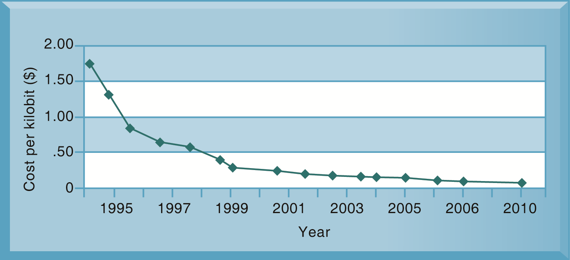
EXPONENTIAL DECLINES IN INTERNET COMMUNICATIONS COSTS
FIGURE 9
One reason for the growth in the Internet population is the rapid decline in Internet connection and overall communication costs. The cost per kilobit of Internet access has fallen exponentially since 1995. Digital subscriber line (DSL) and cable modems now deliver a kilobit of communication for a retail price of around 2 cents.
Notes:
Emphasize to students how close the communication cost per kilobit has come to an infinitesimal number (nearly 0) since 1995. What implications does this have for the number of people using the Internet? You could once again relate this to the digital divide and emphasize that even now a significant portion of the world lacks access to the Internet and other services, though it has more to do with reasons of insufficient infrastructure than Internet communication costs. One implication: it costs no more to move a gigabyte from New York to San Francisco than it does to move the same amount of information from the top of a building to the basement. This means that data no longer needs to be located “close by” the user.

Slide 18
IT Infrastructure
Technology drivers of infrastructure evolution (cont.)
  Standards and network effects
    Technology standards:
      Specifications that establish the compatibility of products and the ability to communicate in a network.
      Unleash powerful economies of scale and result in price declines as manufacturers focus on the products built to a single standard.
Notes:
What might today’s enterprise infrastructure and Internet have been like without widespread and universal standards, such as Windows, Microsoft Office, Unix, and Ethernet? (Greatly decreased efficiency and confusion, inability to develop innovative products everyone can use based on a single standard, etc.)

Slide 19
Infrastructure Components
IT Infrastructure has seven main components
  Computer hardware platforms
  Operating system platforms
  Enterprise software applications
  Data management and storage
  Networking/telecommunications platforms
  Internet platforms
  Consulting system integration services
Notes:
The upcoming slides will go over each component in more detail.

Slide 20
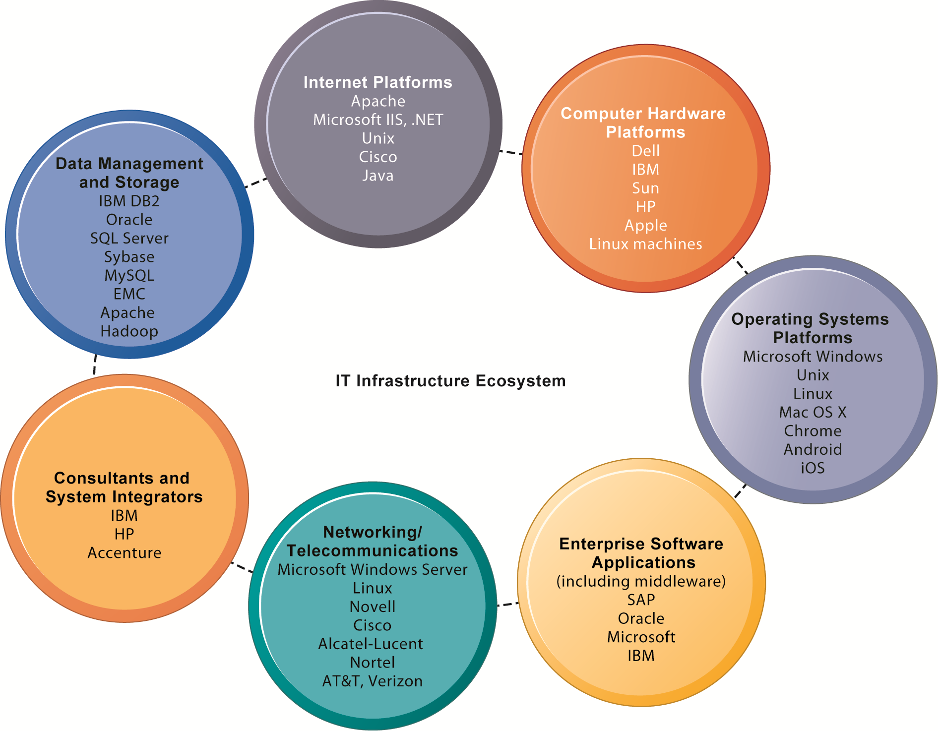
THE IT INFRASTRUCTURE ECOSYSTEM
There are seven major components that must be coordinated to provide the firm with a coherent IT infrastructure. Listed here are major technologies and suppliers for each component.
FIGURE 10
Notes:
Ask students to take a look at the example companies that appear under each heading. What companies appear repeatedly? How many items are unfamiliar?

Slide 21
Infrastructure Components
Computer hardware platforms
  Client machines
    Desktop PCs, mobile devices—PDAs, laptops
  Servers
    Blade servers: ultrathin computers stored in racks
  Mainframes:
    IBM mainframe equivalent to thousands of blade servers
  Top chip producers: AMD, Intel, IBM
  Top firms: IBM, HP, Dell, Sun Microsystems
Notes:
To give students an idea of the size of the market for computer hardware, in 2013, firms worldwide will spend $448 billion on computer hardware.

Slide 22
Infrastructure Components
Operating system (OS) platforms
  Operating systems
    Server level: 65% run Unix (flavours e.g. Solaris, Redhat, Debian) or Linux (distros e.g. Fedora, OpenSUSE, Ubuntu); 35% run Windows (2K, 03, 03R2, 08, 08R2,12, 12R2)
    Client level:
      90% run Microsoft Wins – GUI for MSDOS i.e. Win 9x, NT Family (XP, Vista, 7, 8), Multilingual Support, Multiplatform Support e.g. Itanium, x-86, WinsRT in Wins8 for ARM arch, CE.
      Mobile: (Android – based on Linux kernel-beta ’07, 1.0 ‘08, codenames since ‘09-Cupcake1.5, Donut1.6. Eclair2.0-2.1, Froyo2.2-2.2.3, Gingerbread2.3-2.3.7, Honeycomb3.0-3.2.6, ICS4.0-4.0.4, JellyBean4.1-4.3, KitKat4.4 on Nov’13, iOS).
      Cloud computing: (Google’s Chrome OS) – freeware, most of source code rel. in ’09 exc. PDFViewer & Flashplayer opensource in Chromium Project.
Notes:
Emphasize Microsoft’s traditional dominance in operating systems and explain that it is the most important reason for their success to date. The market for enterprise software applications is approximately $250 billion dollars. These applications are considered to be part of IT infrastructure. Traditionally, large firms were the most prominent users of enterprise software, but firms such as Microsoft are trying to move into the untapped market of small- and medium-size businesses that might benefit from less expansive versions of the same software. Today, the proliferation of operating systems for smartphones and tablet computers (mostly iOS and Android) are mounting a challenge to Microsoft’s dominance which depends heavily on the continued existence of personal computers.

Slide 23
Infrastructure Components
Enterprise software applications
  Enterprise application providers: SAP and Oracle
  Middleware providers: BEA Systems - company specialized in enterprise infrastructure software products which was wholly acquired by Oracle Corporation on April 29th 2008.
Notes:
Emphasize Microsoft’s traditional dominance in operating systems and explain that it is the most important reason for their success to date. The market for enterprise software applications is approximately $250 billion dollars. These applications are considered to be part of IT infrastructure. Traditionally, large firms were the most prominent users of enterprise software, but firms such as Microsoft are trying to move into the untapped market of small- and medium-size businesses that might benefit from less expansive versions of the same software. Today, the proliferation of operating systems for smartphones and tablet computers (mostly iOS and Android) are mounting a challenge to Microsoft’s dominance which depends heavily on the continued existence of personal computers.

Slide 24
Infrastructure Components
Data management and storage
  Database software:
    IBM (DB2), Oracle, Microsoft (SQL Server), Sybase (Adaptive Server Enterprise), MySQL
  Physical data storage:
    EMC Corp (large-scale systems), Seagate, Maxtor, Western Digital
  Storage area networks (SANs):
    Connect multiple storage devices on dedicated network
Notes:
Remind students that the amount of new information in the world is doubling every three years, driving the need for more efficient data management and storage.

Slide 25
Infrastructure Components
Networking/telecommunications platforms
  Telecommunication services
    Telecommunications, cable, telephone company charges for voice lines and Internet access
    AT&T, Verizon, Safaricom, Airtel, Orange
  Network operating systems:
    Windows Server, Linux, Unix
  Network hardware providers:
    Cisco, Alcatel-Lucent, Nortel, Juniper Networks
Notes:
Firms spend $400 billion a year on telecommunications hardware and a $1.7 billion on telecommunications services.

Slide 26
Infrastructure Components
Internet platforms
  Hardware, software, management services to support company Web sites, (including Web-hosting services) intranets, extranets
  Internet hardware server market: IBM, Dell, Sun (Oracle), HP
  Web development tools/suites: Microsoft (Expression Studio, .NET) Oracle-Sun (Java), Adobe, Real Networks
Notes:
Internet platforms are yet another area where Microsoft is featured prominently. Students at this point should be able to appreciate the sheer size of the company. The trend since the late 1990s has been to reduce the number of servers by increasing their size and power. Dell, HP/Compaq, and IBM have been the beneficiaries of this trend. Multi-core processors and blade servers are two ways in which server power can be radically increased without increasing the footprint or the power requirements.

Slide 27
Infrastructure Components
Consulting and system integration services
  Even large firms do not have resources for full range of support for new, complex infrastructure
  Software integration: ensuring new infrastructure works with legacy systems
  Legacy systems: older TPS created for mainframes that would be too costly to replace or redesign
  Accenture, IBM Global Services, EDS, Infosys, Wipro
Notes:
Implementing new infrastructure requires significant changes in business processes and procedures, training and education, and software integration. This is a task that firms struggle to achieve on their own, which drives the need for these services. The MIS course provides students with an excellent background to be a business systems consultant. Most business consulting today involves developing business processes and supporting systems. You might visit a job/career site in class to review the kinds of jobs available to students with IS or MIS majors. One recent report (2010) found that MIS majors were the most satisfied group of college graduates because their education led directly to a job! The survey, which was conducted by PayScale.com and reported in the Wall Street Journal October 12, 2010, found 54% of MIS majors were very satisfied with their majors. Psychology majors at 26% were the least satisfied.

Slide 28
Contemporary Hardware Platform Trends
The mobile digital platform
  Cell phones, smartphones (iPhone, Android, and Blackberry)
    Data transmission, Web surfing, e-mail, and IM duties
  Netbooks:
    Small lightweight notebooks optimized for wireless communication and core tasks
  Tablets (iPad)
  Networked e-readers (Kindle and Nook)
Notes:
Business computing is increasingly moving from PCs and desktops to mobile devices, and managers are increasingly using these to coordinate work and communicate with employees. Students may think the smartphone they own is just a phone, or music player, but for businesses it is becoming an important management tool. Ask students for examples of how they are using smartphones in their business or work.

Slide 29
Contemporary Hardware Platform Trends
BYOD (Bring your own device)
  Allowing employees to use personal mobile devices in workplace
Consumerization of IT
  New information technology emerges in consumer markets first and spreads to business organizations
  Forces businesses and IT departments to rethink how IT equipment and services are acquired and managed
Notes:
In the past, IT departments in large firms dictated to their employees what kinds of devices they could use, both on site and off site while traveling. Increasingly, employees are telling the IT department what tools they want to use, and demanding that IT support these tools.

Slide 30
Contemporary Hardware Platform Trends
Grid computing
  Connects geographically remote computers into a single network to combine processing power and create virtual supercomputer
  Provides cost savings, speed, agility
Virtualization
  Allows single physical resource to act as multiple resources (i.e. run multiple instances of OS)
  Reduces hardware and power expenditures
  Facilitates hardware centralization
  E.g. VMWare, Hyper-V (Wins), XenServer (opensource)
Notes:
Both grid computing and virtualization allow organizations to optimize their use of resources in new ways. Grid computing allows corporations to take advantage of spare computing power in the form of networked virtual supercomputers. Virtualization allows companies also to take advantage of spare computing power by allowing a single resource to act as multiple resources.

Slide 31
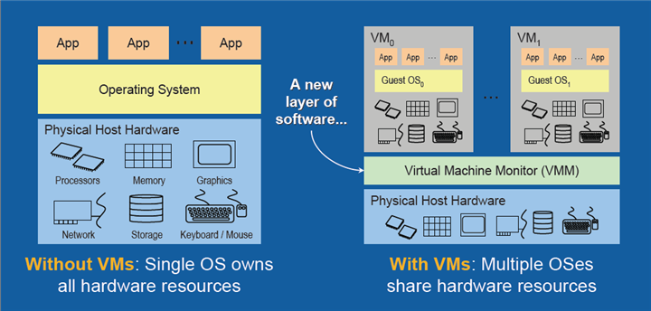
Contemporary Hardware Platform Trends
Notes:
Both grid computing and virtualization allow organizations to optimize their use of resources in new ways. Grid computing allows corporations to take advantage of spare computing power in the form of networked virtual supercomputers. Virtualization allows companies also to take advantage of spare computing power by allowing a single resource to act as multiple resources.

Slide 32
Contemporary Hardware Platform Trends
Cloud computing
  On-demand (utility) computing services obtained over network
    Infrastructure as a service (IaaS)
    Platform as a service (PaaS)
    Software as a service (SaaS)
  Cloud can be public or private
  Allows companies to minimize IT investments
  Drawbacks: Concerns of security, reliability
  Hybrid cloud computing model - an environment that employs both private and public cloud services.
Notes:
Explain that on-demand or utility computing describes a payment structure in which use is dependent upon actual time or power used. Cloud computing refers to a platform—networked access to remote services. Cloud computing allows organizations to avoid the expenses of maintaining their own hardware and software, relying on the cloud instead. Ask students if they have used Google Apps or other forms of cloud computing. Are there any other concerns they might have over transferring computing resources to a shared “cloud”? Have they read about Amazon Web Services going down and offline for short periods of time?

Slide 33
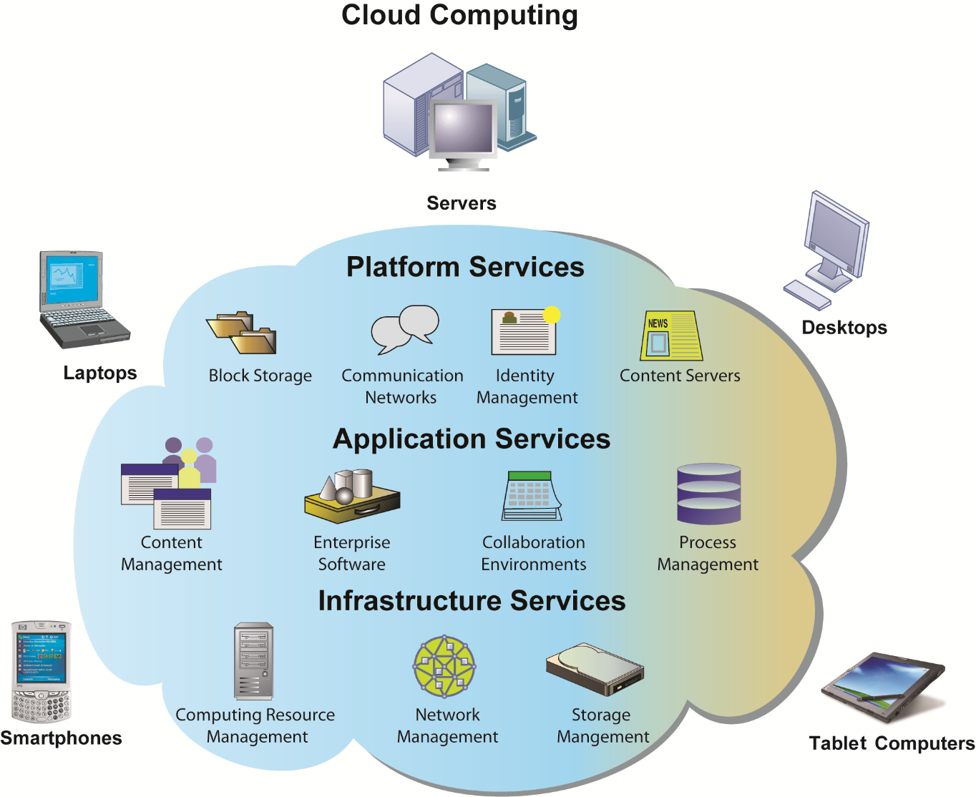
CLOUD COMPUTING PLATFORM
In cloud computing, hardware and software capabilities are a pool of virtualized resources provided over a network, often the Internet. Businesses and employees have access to applications and IT infrastructure anywhere, at any time, and on any device.
FIGURE 11

Slide 34
Contemporary Hardware Platform Trends
Green computing
  Practices and technologies for manufacturing, using, disposing of computing and networking hardware.
High performance, power-saving processors
  Multi-core processors
Autonomic computing
  Industry-wide effort to develop systems that can configure, heal themselves when broken, and protect themselves from outside intruders.
  Similar to self-updating antivirus software; Apple and Microsoft both use automatic updates.
Notes:
Data centers will use approximately 2% of all U.S. electrical power. Cutting power consumption in data centers has become both a serious business and environmental challenge. Ask students what forms of green computing they have noticed. Answers may range from more publicized local management of electronic equipment disposal and recycling to the use of solar chargers, and so on. Another driver in minimizing the power consumption of computer processors is the proliferation of handheld devices; to reduce heat in the devices as well as lengthen time between battery charges.

Slide 35
Contemporary Software Platform Trends
Open-source software:
  Produced by community of programmers
  Free and modifiable by user
  Examples: Apache web server, Mozilla Firefox browser, OpenOffice
Linux
  Open-source OS
  Used in mobile devices, local area networks, Web servers, high-performance computing.
Notes:
Linux plays a major role in the administration of local area networks. Around 20% of the server operating system market is owned by Linux. Ask students to give reasons why an open-source operating system might be a better choice for network administrators than alternatives that are not open-source (such as Microsoft’s Windows server).

Slide 36
Contemporary Software Platform Trends
Software for the Web
  Java:
    Object-oriented programming language
    Operating system, processor-independent
  HTML/HTML5
    Web page description language
    Specifies how text, graphics are placed on Web page
    HTML5 is latest evolution
      Includes animation and video processing functionality previously provided by third party add-ons such as Flash.
Notes:
Java is designed to run on any computing device by use of the Java Virtual Machine. This includes mobile devices such as smartphones. HTML is a markup/formatting tool that creates Web pages that all browsers can interpret and display regardless of the type or manufacture of the computer being used.

Slide 37
Contemporary Software Platform Trends
Web Services
  Software components that exchange information using Web standards and languages.
  XML: Extensible Markup Language
    More powerful and flexible than HTML
    Tagging allows computers to process data automatically.
  JSON (JavaScript Object Notation): a text-based open standard designed for human-readable data interchange. Derived from the JavaScript scripting language.
Notes:
Firms are collections of thousands of computer programs and systems built over many years. In general, these systems cannot “talk” with one another, and sharing information among them is very expensive. One way to get to work together is to build software links among them. This is the Web services approach (see the next slide on service oriented architecture). You can compare it to the Web: any computer with a browser can access billions of Web pages and draw down the information, or download PDF files that work on all computers that have a version of Adobe acrobat installed. In a business firm, you want a similar environment: any computer program can get data from any other computer program. Web services makes this possible.
Ensure that students are able to explain the difference between XML and HTML (in other words, the additional features XML has compared to HTML). These include classifying, presenting, communicating, and storing data, as opposed to HTML being able to merely present data. These features also allow computers to manipulate documents written in XML automatically. Does this remind students of autonomic computing?

Slide 38
Contemporary Software Platform Trends
Web Services (cont’d)
  Differences between XML & JSON
    XML more verbose so JSON faster to write for humans.
    XML used for structured data excl. arrays
    Jscript’s eval method parses JSON to return a described object.
    XML is a markup language – suitable for doc. descr. hence hierarchical elements can have attributes while JSON has concise syntax to describe lists of elements hence suitable for text format object serialization.
    JSON light & compact, easier to parse from Jscript – preferred for browser-based client side apps. Need a library to parse XML.
Notes:
Firms are collections of thousands of computer programs and systems built over many years. In general, these systems cannot “talk” with one another, and sharing information among them is very expensive. One way to get to work together is to build software links among them. This is the Web services approach (see the next slide on service oriented architecture). You can compare it to the Web: any computer with a browser can access billions of Web pages and draw down the information, or download PDF files that work on all computers that have a version of Adobe acrobat installed. In a business firm, you want a similar environment: any computer program can get data from any other computer program. Web services makes this possible.
Ensure that students are able to explain the difference between XML and HTML (in other words, the additional features XML has compared to HTML). These include classifying, presenting, communicating, and storing data, as opposed to HTML being able to merely present data. These features also allow computers to manipulate documents written in XML automatically. Does this remind students of autonomic computing?

Slide 39
Contemporary Software Platform Trends
Web Services (cont’d)
  Example XML
    <car>
    <company>Volkswagen</company>
    <name>Vento</name>
    <price>1000000</price>
    </car>
Notes:
Firms are collections of thousands of computer programs and systems built over many years. In general, these systems cannot “talk” with one another, and sharing information among them is very expensive. One way to get to work together is to build software links among them. This is the Web services approach (see the next slide on service oriented architecture). You can compare it to the Web: any computer with a browser can access billions of Web pages and draw down the information, or download PDF files that work on all computers that have a version of Adobe acrobat installed. In a business firm, you want a similar environment: any computer program can get data from any other computer program. Web services makes this possible.
Ensure that students are able to explain the difference between XML and HTML (in other words, the additional features XML has compared to HTML). These include classifying, presenting, communicating, and storing data, as opposed to HTML being able to merely present data. These features also allow computers to manipulate documents written in XML automatically. Does this remind students of autonomic computing?

Slide 40
Contemporary Software Platform Trends
Web Services (cont’d)
  Example JSON
  {
  “company”: Volkswagen
  “name”: Vento
  “price”: 1000000
  }
Notes:
Firms are collections of thousands of computer programs and systems built over many years. In general, these systems cannot “talk” with one another, and sharing information among them is very expensive. One way to get to work together is to build software links among them. This is the Web services approach (see the next slide on service oriented architecture). You can compare it to the Web: any computer with a browser can access billions of Web pages and draw down the information, or download PDF files that work on all computers that have a version of Adobe acrobat installed. In a business firm, you want a similar environment: any computer program can get data from any other computer program. Web services makes this possible.
Ensure that students are able to explain the difference between XML and HTML (in other words, the additional features XML has compared to HTML). These include classifying, presenting, communicating, and storing data, as opposed to HTML being able to merely present data. These features also allow computers to manipulate documents written in XML automatically. Does this remind students of autonomic computing?

Slide 41
Contemporary Software Platform Trends
SOA: Service-oriented architecture
  Set of self-contained services that communicate with each other to create a working software application
  Software developers reuse these services in other combinations to assemble other applications as needed
    Example: an “invoice service” to serve whole firm for calculating and sending printed invoices
  Dollar Rent A Car
    Uses Web services to link online booking system with Southwest Airlines’ Web site
Notes:
Emphasize that SOA is a method of developing infrastructure using Web services with an eye toward creating applications that draw data from several underlying (usually older “legacy” programs). All programs are built or redesigned to provide certain information (services) to all other programs. With SOA, developers incorporate each individual service into an application that successfully meets the needs of the organization.

Slide 42
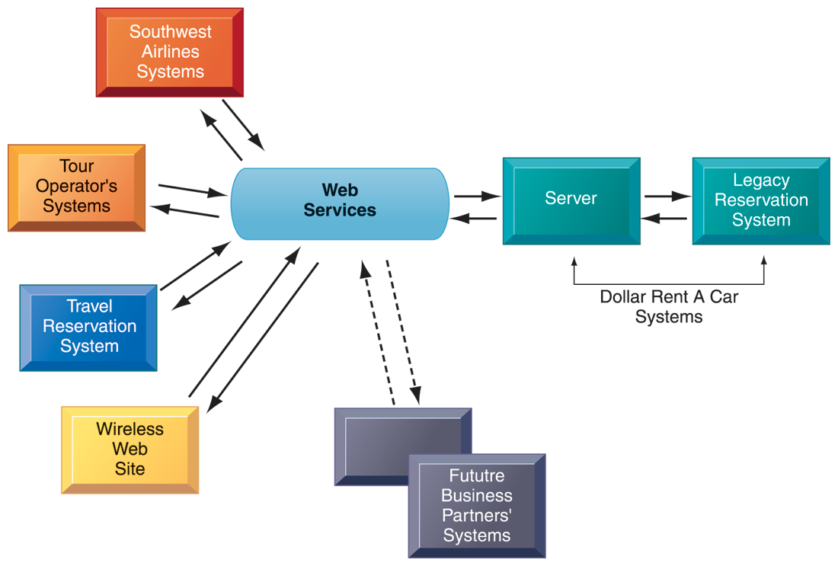
HOW DOLLAR RENT A CAR USES WEB SERVICES
FIGURE 12
Dollar Rent A Car uses Web services to provide a standard intermediate layer of software to “talk” to other companies’ information systems. Dollar Rent A Car can use this set of Web services to link to other companies’ information systems without having to build a separate link to each firm’s systems.
Notes:
Emphasize that the task Dollar wants to complete (interacting with other companies’ information systems) is represented here as a collection of individual services, in keeping with the SOA model. Dollar wants to be able to quickly and easily share data with other companies—the series of services provided above are combined to accomplish that task.

Slide 43
Contemporary Software Platform Trends
Software outsourcing and cloud services
  Three external sources for software:
    Software packages and enterprise software
      In-house
    Software outsourcing
      Contracting outside firms to develop software
    Cloud-based software services
      Software as a service (SaaS)
      Accessed with Web browser over Internet
      Service Level Agreements (SLAs): formal agreement with service providers
Notes:
This slide discusses the trend in software outsourcing and in cloud software services. Remind students that internal sources for software refers to developing software fully in house. Most companies today purchase or lease software or outsource development. Why do students think that software outsourcing is growing quickly in popularity? How about offshore outsourcing (mostly to India and other English-speaking, developing countries)? Ask students what types of software they have used online. Note that service level agreements are formal contracts between customers and their service providers that define the specific responsibilities of the service provider and the service expected by the customer. These are important to establish communication between the two firms and to manage the project efficiently.

Slide 44
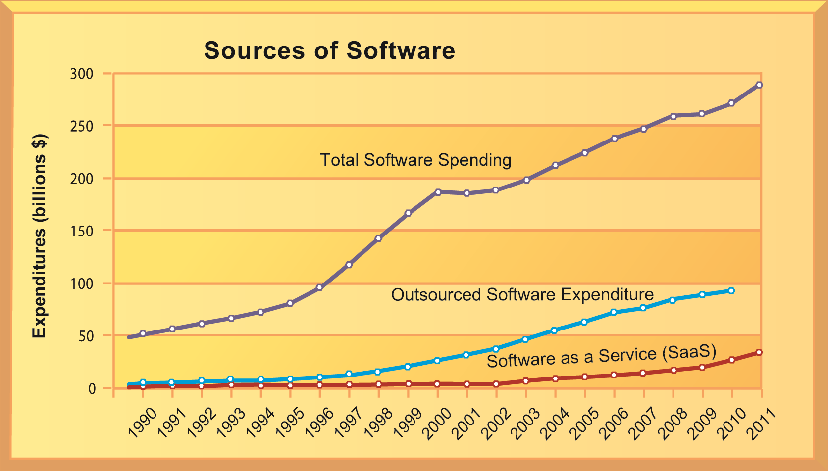
CHANGING SOURCES OF FIRM SOFTWARE
FIGURE 13
In 2012, U.S. firms will spend more than $279 billion on software. About 35 percent of that ($98 billion) will originate outside the firm, either from enterprise software vendors selling firmwide applications or individual application service providers leasing or selling software modules. Another 4 percent ($11 billion) will be provided by SaaS vendors as an online cloud-based service.
Notes:
Note the recent jump in SaaS spending within the last several years, and the pronounced rise in the last two or three years. What are the positives and negatives of acquiring software through the SaaS model? Positives: allows companies to focus on business issues rather than technology; for many companies, SaaS could cut costs. Negatives: SaaS increases the firm’s dependency on external suppliers. What happens if your supplier of SaaS services goes into bankruptcy? What is your backup plan?

Slide 45
Contemporary Software Platform Trends
Software outsourcing and cloud services (cont’d)
  Mashups
    Combinations of two or more online applications, such as combining mapping software (Google Maps) with local content.
  Apps
    Small pieces of software that run on the Internet, on your computer, or on your cell phone.
      iPhone, Android
    Generally delivered over the Internet.
Notes:
In addition to the large enterprise software packages and services, some business tasks can be enabled through smaller programs or components that are combined to create a new function. The open-source movement, and the universal standards of Internet technologies, have created an environment in which software components can be created, used, and shared easily. Ask students which mashups and apps they have used. Have any students created any mashups or apps?

Slide 46
Management Issues
Dealing with platform and infrastructure change
  As firms shrink or grow, IT needs to be flexible and scalable
  Scalability:
    Ability to expand to serve larger number of users
  For mobile computing and cloud computing
    New policies and procedures for managing these new platforms
    Contractual agreements with firms running clouds and distributing software required
Notes:
How can IT be flexible and still make long-term investments in hardware and software? SaaS may solve some problems, but ask students to envision some of the pitfalls of working with an external hardware or software vendor such as Google or Salesforce.com. What are some nightmare scenarios that companies must guard against? For instance, the vendor fails to make critical applications available when needed, poor customer service, and so on, or the vendor fails to upgrade equipment in order to save investment monies.

Slide 47
Management Issues
Management and governance
  Who controls IT infrastructure?
  How should IT department be organized?
    Centralized
      Central IT department makes decisions
    Decentralized
      Business unit IT departments make own decisions
  How are costs allocated between divisions, departments?
Notes:
What are the ramifications of poor IT governance at a firm? For example, if a company does not clearly define what departments have the responsibility to make their own IT decisions, what could be the consequences? Some potential consequences are data mismanagement, poor communication, and slower response times to crises.

Slide 48
Management Issues
Making wise infrastructure investments
  Amount to spend on IT is a complex question
    Rent vs. buy, cloud computing
    Outsourcing
  Total cost of ownership (TCO) model
    Analyzes direct and indirect costs
    Hardware, software account for only about 20% of TCO
    Other costs: Installation, training, support, maintenance, infrastructure, downtime, space, and energy
  TCO can be reduced
    Use of cloud services, greater centralization and standardization of hardware and software resources.
Notes:
What types of companies should opt to rent as opposed to buy software? Possibly, companies with seasonal employees or semi-annual workloads. What differences between the two can students point to?
TCO is a way of quantifying some of the hidden costs of hardware. Ask students to make the connection between the TCO of handling software and hardware infrastructure internally as opposed to acquiring it from an outside vendor. Is this an additional incentive to outsource?

Slide 49
Management Issues
Competitive forces model for IT infrastructure investment
  Market demand for firm’s services
  Firm’s business strategy
  Firm’s IT strategy, infrastructure, and cost
  Information technology assessment
  Competitor firm services
  Competitor firm IT infrastructure investments
Notes:
How important of an impact do competitors’ services and investments affect a firm’s IT services and infrastructure? Is it wise to rely on those factors alone to determine what kind of services your firm provides? For instance, your competitors may not be the industry’s best example of how to develop IT services. In fact, your entire industry might be technological laggards. In this case, it might be better to look at best practices in other industries which have a reputation for superior IT services and capabilities.

Slide 50
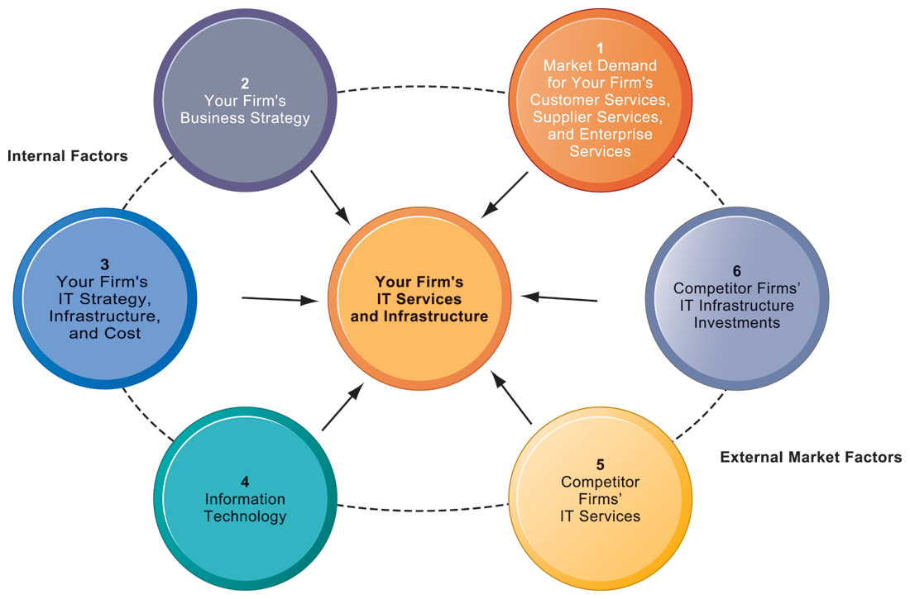
COMPETITIVE FORCES MODEL FOR IT INFRASTRUCTURE
FIGURE 14
There are six factors you can use to answer the question, “How much should our firm spend on IT infrastructure?”
Notes:
Ask students to explain how each item affects a firm’s IT services and infrastructure. Do they feel that any one of the six is especially important (or unimportant)? You can also use this diagram as a framework for understanding why some firms fail to develop a workable, powerful IT infrastructure.

Slide 51
The Army Recasts its IT Infrastructure
Problem: Costly and unwieldy IT infrastructure; diminishing resources.

Slide 52
The Army Recasts its IT Infrastructure
Solution:
  Streamline data centers
  Implement enterprise-wide computing
  Employ new technologies: virtualization, mobile systems
Demonstrates IT’s role in improving performance and decreasing costs

Slide 53
IT Infrastructure and Emerging Technologies
VIDEO CASES
  Case 1: ESPN.com: Getting to eXtreme Scale On the Web
  http://www.youtube.com/watch?v=NIqru81sjV4
  Case 2: Salesforce.com: Managing by Smartphone
  http://www.youtube.com/watch?v=fwo2VbDA1Io
  Case 3: Hudson's Bay Company and IBM: Virtual Blade Platform
  http://www.youtube.com/watch?v=p11lJOnALS4

Slide 54
Summary
Evolution of IT Infrastructure
Moore’s Law and Microprocessor performance
IT Infrastructure Components:
    Hardware Platforms
    OS Platforms
    Enterprise Software apps
    Data management and storage
    Networking/Telecommunications platforms
    Internet platforms
    Consulting system integration services
Notes:
Students may not know exactly what is meant by globalization or may have an incomplete understanding of the term. You might ask students what they think it means. Potential answers could include: reduction of economic and cultural advantages of developed countries, increased number of companies with operations in multiple countries worldwide, and increased reliance on imports and exports of goods (and jobs). Globalization will be discussed in later slides as well.

Slide 55
Summary
Contemporary Hardware platform Trends:
    The mobile digital Platforms
    BYOD
    Consumerization of IT
    Grid Computing
    Virtualization
    Cloud Computing
    Green Computing
    Autonomic Computing
    High performance, power-saving processors
Notes:
Students may not know exactly what is meant by globalization or may have an incomplete understanding of the term. You might ask students what they think it means. Potential answers could include: reduction of economic and cultural advantages of developed countries, increased number of companies with operations in multiple countries worldwide, and increased reliance on imports and exports of goods (and jobs). Globalization will be discussed in later slides as well.

Slide 56
Summary
Contemporary Software platform Trends:
    Open-source software
    Linux
    Software for the Web
    Web Services
    SOA
    Software outsourcing and cloud services
Notes:
Students may not know exactly what is meant by globalization or may have an incomplete understanding of the term. You might ask students what they think it means. Potential answers could include: reduction of economic and cultural advantages of developed countries, increased number of companies with operations in multiple countries worldwide, and increased reliance on imports and exports of goods (and jobs). Globalization will be discussed in later slides as well.

Slide 57
Next Week……
Foundations of Business Intelligence: Databases and Information Management
Telecommunications, the Internet and Wireless Technology

